Slide 1
Explore AI Basics

Slide 2
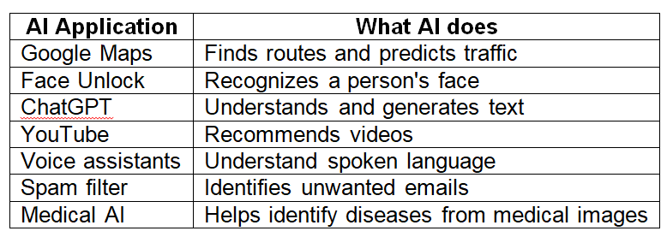
Introduction
AI is the ability of machines to perform tasks that normally require human intelligence.

Slide 3
AI vs. Human Intelligence
AI and human intelligence are not the same.
Suppose you show a child three pictures of cats.
The child can probably understand that the pictures represent cats.
An AI image-recognition system may require thousands or millions of examples to learn the patterns associated with cats.

Slide 4
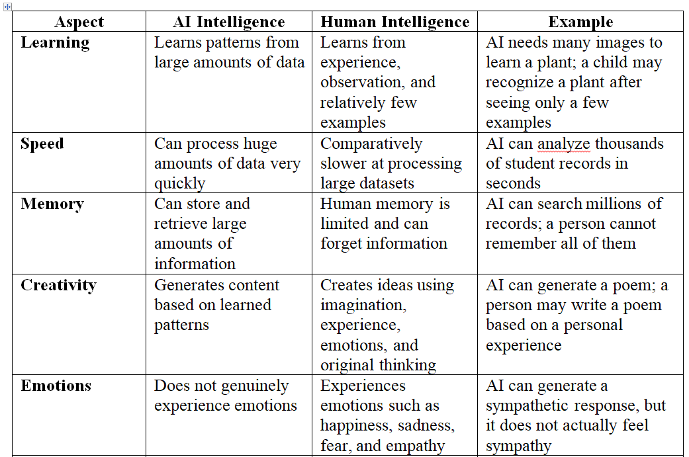
AI vs. Human Intelligence

Slide 5
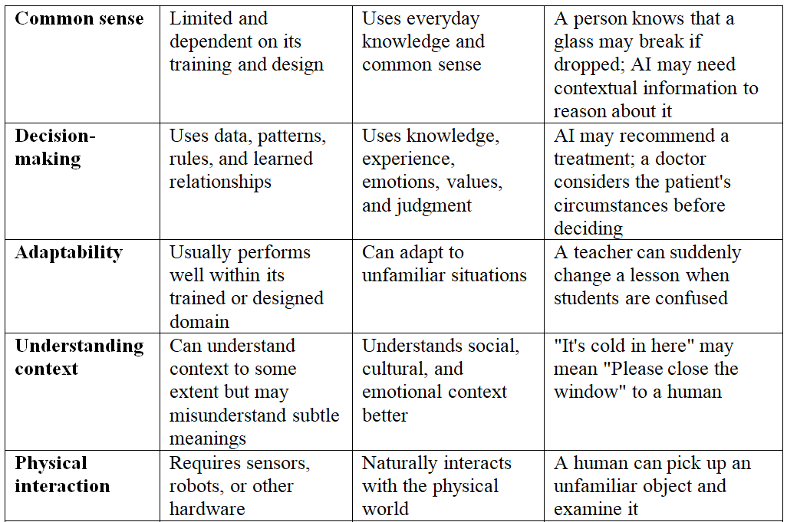
AI vs. Human Intelligence

Slide 6
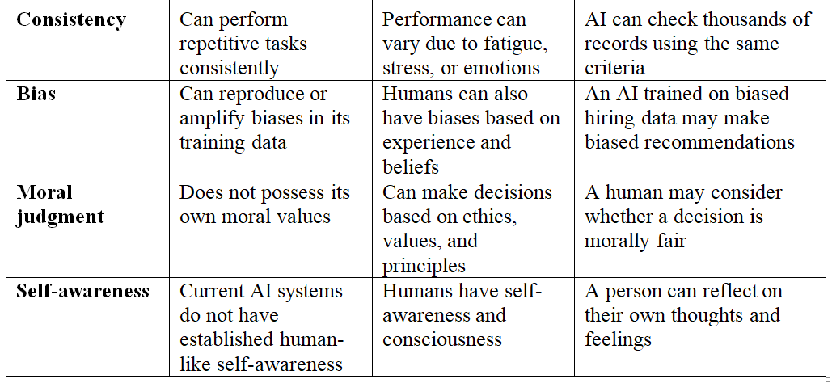
AI vs. Human Intelligence

Slide 7
Knowledge vs. Intelligence
Knowledge is information that a person or system has learned or acquired.
Intelligence is the ability to use knowledge to understand, reason, solve problems, and make decisions.

Slide 8
History of Artificial Intelligence
1940s–1950s — Early Computing & Neural-Network Ideas
Development of electronic computers.
Researchers began thinking about whether machines could imitate human thinking.
Can a machine also learn or think?

Slide 9
History of Artificial Intelligence
1950s — Birth of Artificial Intelligence
1956: The term Artificial Intelligence (AI) became established at the Dartmouth workshop.
Researchers began treating AI as a formal field of study
1960s–1970s — Early AI Programs
Development of programs that could:
Solve problems
Play games
Understand simple language
Perform logical reasoning

Slide 10
History of Artificial Intelligence
1980s — Expert Systems
Expert systems became an important area of AI.
These systems used:
Knowledge base → stored expert knowledge
Rules → IF–THEN rules
Inference engine → applied the rules to reach conclusions
Example:
IF patient has fever AND cough THEN possible respiratory infection.

Slide 11
History of Artificial Intelligence
1990s–2000s — Machine Learning Becomes Important
2010s — Deep Learning Revolution
Deep learning, using multi-layer neural networks, became highly successful.
Large datasets + powerful GPUs + improved algorithms accelerated AI.

Slide 12
History of Artificial Intelligence
2020s — Generative AI
AI systems became capable of generating new content, rather than simply classifying or predicting existing information.
Major developments include:
Large Language Models (LLMs)
Text generation
Image generation
Code generation
Audio and video generatio

Slide 13
Data Everywhere
AI depends heavily on data.
Examples of data
Text, Images, Audio, Video, Numbers, Sensor, readings, Location information, Web activity
Why is data important to AI?
Data → Find patterns → Learn → Make→ predictions/decisions

Slide 14
Machine Learning
Machine Learning (ML) is a branch of AI in which computers learn patterns from data rather than being explicitly programmed with every rule.

Slide 15
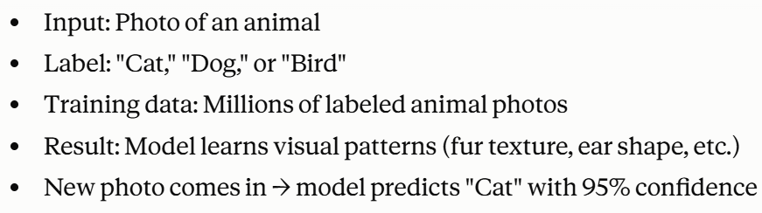
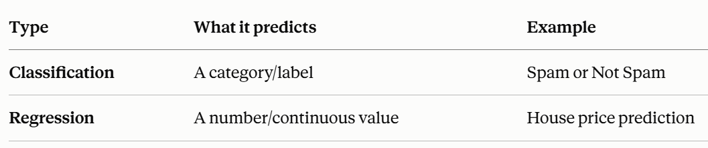
Types of Machine Learning
Supervised Learning
The training data contains known answers/labels.

Slide 16
Types of Machine Learning
Unsupervised Learning
The data does not have predefined labels.
The system tries to discover patterns or groups.
Example 1: News Article Grouping
Input: Thousands of news articles, no topic labels
Model discovers: Articles naturally cluster into groups like "sports," "politics," "technology" based on word patterns
Example 2: Customer Segmentation (Clustering)
Input: Customer data (age, spending habits, purchase frequency) — no labels
Model discovers: Group A = "young, frequent small purchases," Group B = "older, occasional large purchases"

Slide 17
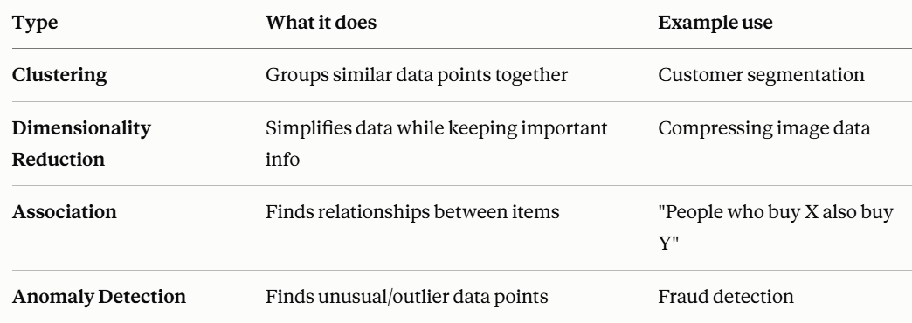
Types of Machine Learning
Unsupervised Learning

Slide 18
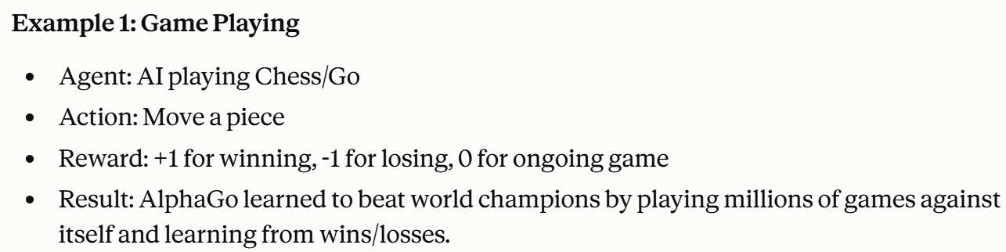
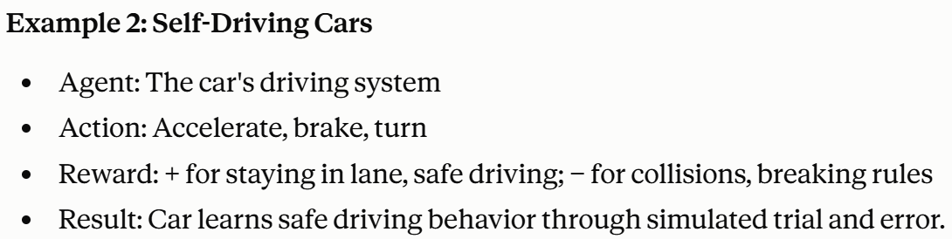
Reinforcement Learning
The model (called an "agent") learns by trial and error

Slide 19
Deep Learning
Deep Learning is a type of machine learning that uses artificial neural networks with multiple layers.
Applications
Face recognition
Speech recognition
Image classification
Autonomous vehicles
Medical image analysis
Generative AI

Slide 20
Natural Language Processing (NLP)
Natural Language Processing (NLP) is a branch of AI that enables computers to understand, process, and generate human language.
Examples
ChatGPT
Translation systems
Voice assistants
Sentiment analysis
Chatbots
Grammar checking
Speech recognition

Slide 21
AI Algorithms
AI algorithms process data and help a system learn patterns, make predictions, or make decisions.
Examples include:
Decision trees
Linear regression
Logistic regression
K-nearest neighbors
Neural networks
Clustering algorithms

Slide 22
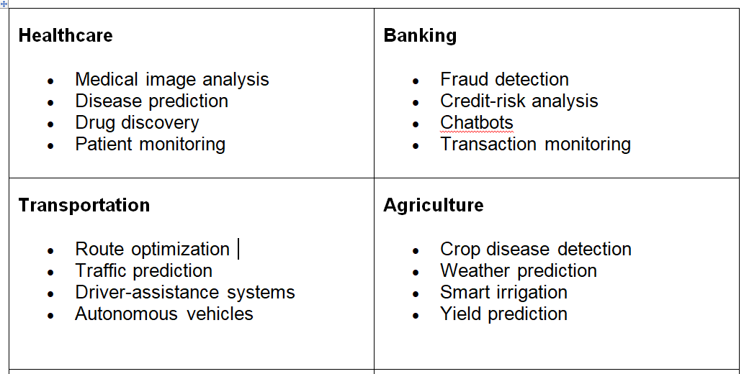
AI in Action

Slide 23
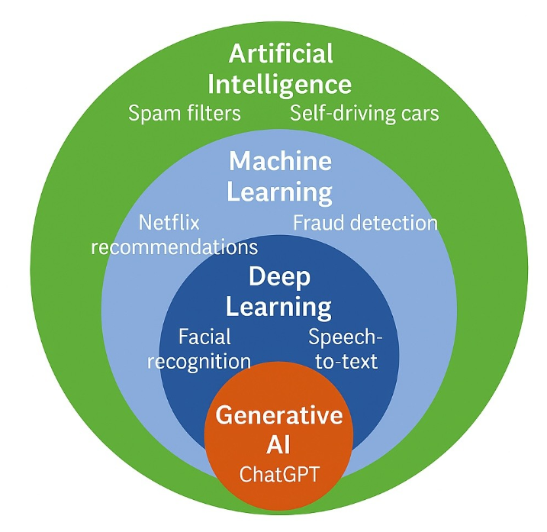
Relationship Between AI, ML and Deep Learning

